Slide 1
Owid Energy
~ Dhruvi Prajapati

Slide 2
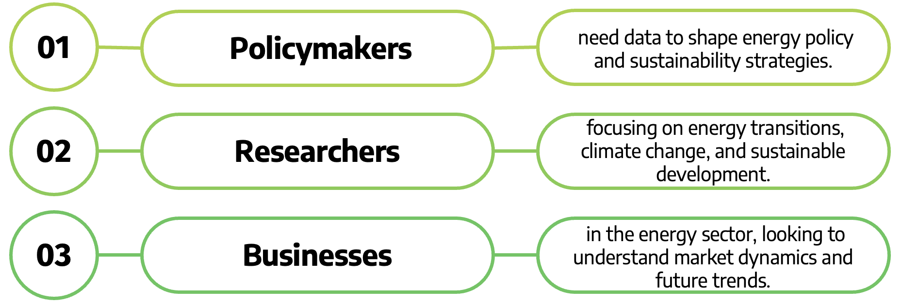
What is Energy: Energy is a fundamental concept in both science and daily life, and it refers to the capacity to do work. Question: What are the global energy production and consumption patterns, and how do they relate to economic, environmental, and social factors? Purpose of Analysis: To analyze global energy trends using data from the OWID Energy Database, identifying key patterns in energy production, consumption, and emissions. TARGET

Slide 3
For the project, Our World in Data (OWID) Energy Dataset. The data was obtained from the Kaggle website, available as CSV files. Characteristic of the data Energy Consumption: Measured in terawatt-hours (TWh) CO2 Emissions: Linked to energy production and consumption. GDP and Population: Used to calculate energy efficiency and the energy intensity of economies Data Contents Biofuel, Coal, Electricity, Fossils, Gas, Hydro, Carbon, Nuclear, Oil, Renewable, Solar and Wind. Tools Used While Analysis Data Jupyter Notebooks for data analysis and visualization. Python Libraries: Pandas for data manipulation. Matplotlib and Seaborn for creating visualizations. Insights from the Analysis - Energy consumption is increasing globally, with a clear shift towards renewable energy sources in high-income nations, but fossil fuels remain dominant worldwide. - Despite renewable growth, the global energy transition is slow, with CO2 emissions from energy consumption continuing to rise.

Slide 4
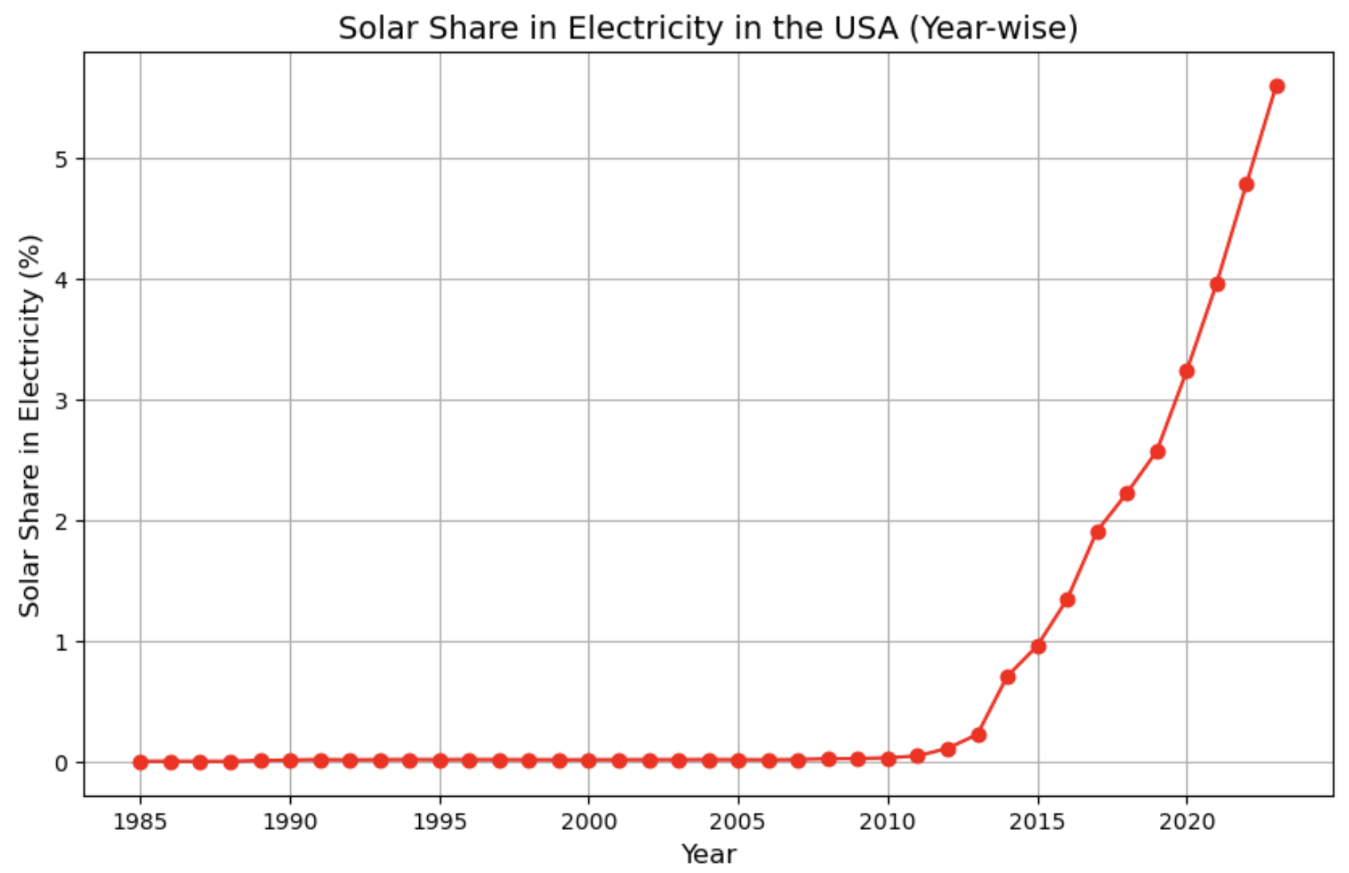
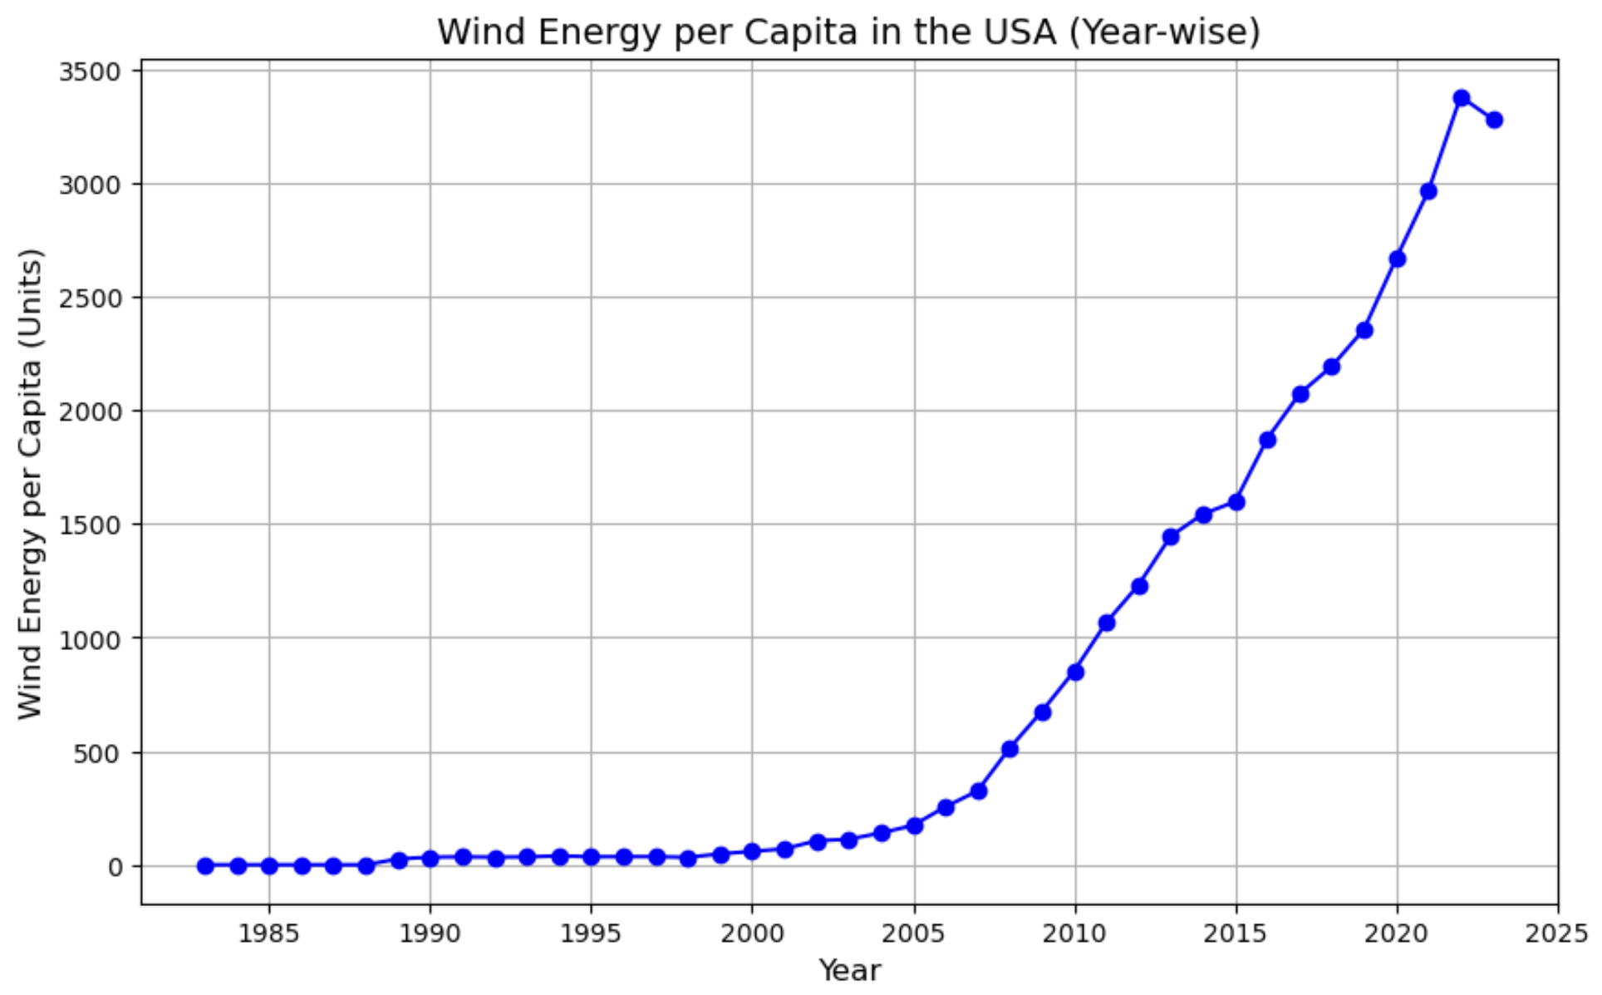
The solar share in electricity in the USA increased from 1985 to 2010 and then decreased from 2010 to 2020.
The wind energy per capita in the USA has been decreasing since 1990.

Slide 5
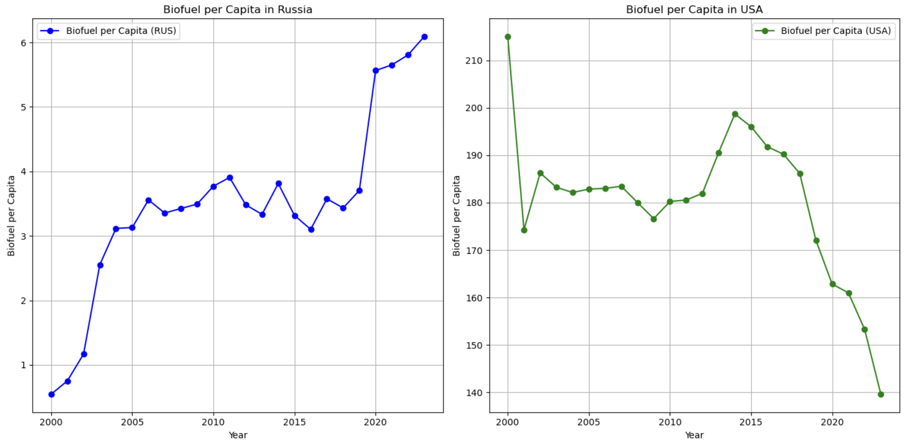
Year VS Biofuel per capita of Russia and USA
The biofuel per capita in Russia and the USA is about the same in 2020.
Brazil and the U.S. are major biofuel producers.

Slide 6
Future Work:
New Questions occurs : Which country accelerates the adoption of renewable energy globally? How do specific countries' energy policies correlate with changes in emissions and energy consumption? Further Analysis Needed: A deeper dive into the role of energy efficiency in reducing emissions. A comparison of the energy mix and its relationship to economic growth rates across countries. Collaborative Work: Working with environmental and policy experts to translate these insights into actionable strategies for global sustainability goals.

Slide 7
THANK YOU!

